Slide 1
Python Control Flow
Bs

Slide 2
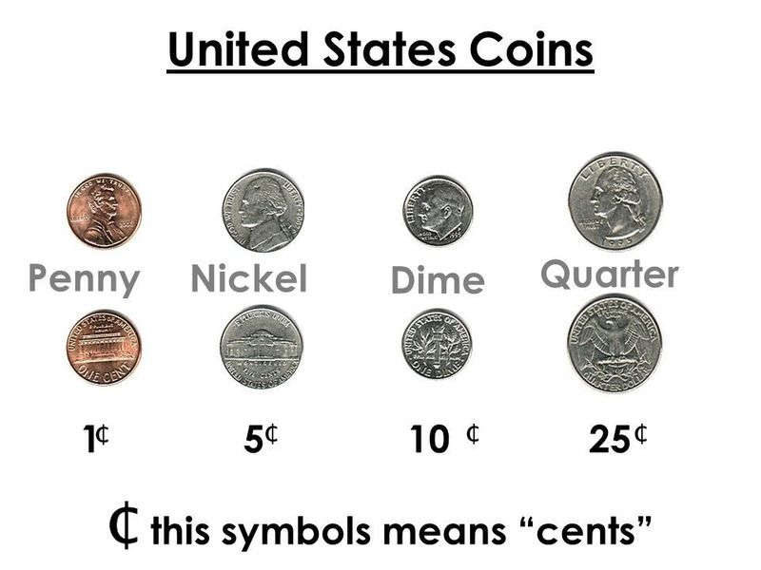
Assignment 1: Discussion
Input: 87 cents
Output:
3 quarters
1 dime
2 pennis

Slide 3
Assignment 1: Discussion
Input: 87 cents
Output:
3 quarters
1 dime
2 pennis
maximum

Slide 4
Assignment 1: Discussion
Input: 87 cents
Output:
3 quarters
1 dime
2 pennis
maximum
cents / 25

Slide 5
Assignment 1: Discussion
Input: 87 cents
Output:
3 quarters
1 dime
2 pennis
maximum
cents / 25
(float)

Slide 6
Assignment 1: Discussion
Input: 87 cents
Output:
3 quarters
1 dime
2 pennis
maximum
cents // 25
(int)

Slide 7
Assignment 1: Discussion
Input: 87 cents
Output:
3 quarters
1 dime
2 pennis
maximum
cents // 25
(int)
Get what is left?

Slide 8
Assignment 1: Discussion
Input: 87 cents
Output:
3 quarters
1 dime
2 pennis
maximum
cents // 25
(int)
Get what is left?
modulo operation

Slide 9
Assignment 1: Discussion
Input: 87 cents
Output:
3 quarters
1 dime
2 pennis
maximum
cents // 10
(int)

Slide 10
Condition Control
Syntax
if condition:
# body of if statement

Slide 11
Condition Control
Boolean expression
Syntax
if condition:
# body of if statement
If condition evaluates to True, the body of the if statement is executed.
If condition evaluates to False, the body of the if statement will be skipped from execution.

Slide 12
Condition Control
Boolean expression (True/False)
Syntax
if condition:
# body of if statement
If condition evaluates to True, the body of the if statement is executed.
If condition evaluates to False, the body of the if statement will be skipped from execution.

Slide 13
Condition Control
Example:
number = int(input('Enter a number: '))
# check if number is greater than 0
if number > 0:
print(f'{number} is a positive number.')
print('A statement outside the if statement.')

Slide 14
Condition Control
Example:
number = int(input('Enter a number: '))
# check if number is greater than 0
if number > 0:
print(f'{number} is a positive number.')
print('A statement outside the if statement.')
number = 5

Slide 15
Condition Control
Example:
number = int(input('Enter a number: '))
# check if number is greater than 0
if number > 0:
print(f'{number} is a positive number.')
print('A statement outside the if statement.')
number = 5
Output: 5 is a positive number.

Slide 16
Condition Control
Example:
number = int(input('Enter a number: '))
# check if number is greater than 0
if number > 0:
print(f'{number} is a positive number.')
print('A statement outside the if statement.')
number = -2

Slide 17
Condition Control
Example:
number = int(input('Enter a number: '))
# check if number is greater than 0
if number > 0:
print(f'{number} is a positive number.')
print('A statement outside the if statement.')
number = -2
Output: A statement outside the if statement.

Slide 18
Condition Control
Example:
number = int(input('Enter a number: '))
# check if number is greater than 0
if number > 0:
print(f'{number} is a positive number.')
print('A statement outside the if statement.')
Python uses indentation to define a block.

Slide 19
Condition Control
Example:
number = int(input('Enter a number: '))
# check if number is greater than 0
if number > 0:
print(f'{number} is a positive number.')
print('A statement outside the if statement.')
Python uses indentation to define a block.
4 spaces for each level

Slide 20
Condition Control
Example:
x = 1
total = 0
# start of the if statement
if x != 0:
  total += x
  print(total)
# end of the if statement
print("This is always executed.")

Slide 21
if…else
Syntax
if condition:
# body of if statement
else:
#body of else statement

Slide 22
if…else
Example
number = int(input('Enter a number: '))
# check if number is greater than 0
if number > 0:
print(f'{number} is a positive number.')
else:
print(f'{number} is a negative number.')
print('A statement outside the if statement.')

Slide 23
if…else
Example
number = int(input('Enter a number: '))
# check if number is greater than 0
if number > 0:
print(f'{number} is a positive number.')
else:
print(f'{number} is a negative number.')
print('A statement outside the if statement.')
number = 5
Output: 5 is a positive number.

Slide 24
if…else
Example
number = int(input('Enter a number: '))
# check if number is greater than 0
if number > 0:
print(f'{number} is a positive number.')
else:
print(f'{number} is a negative number.')
print('A statement outside the if statement.')
number = -2
Output: -2 is a negative number.

Slide 25
if…elif..else
Make a choice between more than two alternatives.
Syntax
if condition1:
# code block 1
elif condition2:
# code block 2
else:
# code block 3

Slide 26
if…elif..else
Make a choice between more than two alternatives.
Syntax
if condition1:
# code block 1
elif condition2:
# code block 2
else:
# code block 3

Slide 27
if…elif..else
Example
number = -5
if number > 0:
print('Positive number')
elif number < 0:
print('Negative number')
else:
print('Zero')
print('This statement is always executed')

Slide 28
Compact if Statement
If statement can be simplified into a single line.
number = 10
if number > 10:
print (f"{number} is a positive number!")
number = 10
if number > 10 : print (f"{number} is a positive number!")

Slide 29
Ternary Operator
A concise way to assign values based on the condition.
Syntax
value_if_true if condition else value_if_false

Slide 30
Ternary Operator
A concise way to assign values based on the condition.
Syntax
value_if_true if condition else value_if_false
Example:
grade = 40
if grade >= 50:
result = 'pass'
else:
result = 'fail'
print(result)
grade = 40
result = 'pass' if grade >= 50 else 'fail'
print(result)

Slide 31
for loop
Syntax:
for variable in sequence :
<body>

Slide 32
for loop
keyword
Syntax:
for variable in sequence :
<body>

Slide 33
for loop
holds the current item during each iteration of the loop
Syntax:
for variable in sequence :
<body>

Slide 34
for loop
Keyword, connects the variable and sequence.
Syntax:
for variable in sequence :
<body>

Slide 35
for loop
Syntax:
Iterable object that you want to iterate over.
for variable in sequence :
<body>

Slide 36
for loop
Syntax:
Marks the end of the for loop header
for variable in sequence :
<body>

Slide 37
for loop
Syntax:
for variable in sequence :
<body>
Indentation

Slide 38
for loop
Syntax:
for variable in sequence :
<body>
range(): generates a sequence of numbers.

Slide 39
for loop
Syntax:
for variable in sequence :
<body>
range(): generates a sequence of numbers.
range(start, stop, step)
Parameter | Description
start | Optional. An integer number specifying at which position to start (inclusive). Default is 0

Slide 40
for loop
Syntax:
for variable in sequence :
<body>
range(): generates a sequence of numbers.
range(start, stop, step)
Parameter | Description
start | Optional. An integer number specifying at which position to start (inclusive). Default is 0
stop | Required. An integer number specifying at which position to stop (exclusive).

Slide 41
for loop
Syntax:
for variable in sequence :
<body>
range(): generates a sequence of numbers.
range(start, stop, step)
Parameter | Description
start | Optional. An integer number specifying at which position to start (inclusive). Default is 0
stop | Required. An integer number specifying at which position to stop (exclusive).
step | Optional. An integer number specifying the incrementation. Default is 1

Slide 42
for loop
Syntax:
for variable in sequence :
<body>
range(): generates a sequence of numbers.
range(start, stop, step)
Example:
for i in range(5):
print(f"Iteration number: {i}")

Slide 43
for loop
keyword
Syntax:
for variable in sequence :
<body>
range(): generates a sequence of numbers.
range(start, stop, step)
Example:
for i in range(5):
print(f"Iteration number: {i}")

Slide 44
for loop
Syntax:
Iterable object that you want to iterate over.
for variable in sequence :
<body>
range(): generates a sequence of numbers.
range(start, stop, step)
Example:
[0, 5)
for i in range(5):
print(f"Iteration number: {i}")

Slide 45
for loop
Syntax:
Iterable object that you want to iterate over.
for variable in sequence :
<body>
range(): generates a sequence of numbers.
range(start, stop, step)
Example:
[0, 5): 0, 1, 2, 3, 4
for i in range(5):
print(f"Iteration number: {i}")

Slide 46
for loop
holds the current item during each iteration of the loop
Syntax:
for variable in sequence :
<body>
range(): generates a sequence of numbers.
range(start, stop, step)
i will be 0, 1, 2, 3, 4
Example:
for i in range(5):
print(f"Iteration number: {i}")

Slide 47
for loop
Syntax:
for variable in sequence :
<body>
range(): generates a sequence of numbers.
range(start, stop, step)
Output:
  Iteration number: 0
  Iteration number: 1
  Iteration number: 2
  Iteration number: 3
  Iteration number: 4
Example:
for i in range(5):
print(f"Iteration number: {i}")

Slide 48
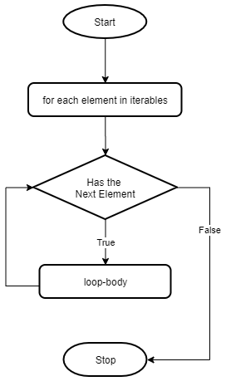
loops
Loops can help remove repetitive code in your program.
for variable in sequence :
<body>
for i in range(5):
print(f"Iteration number: {i}")

Slide 49
Practice
Loops can help remove repetitive code in your program.
for variable in sequence :
<body>
Practice: Create a sequence of numbers from -10 to 10 and print each item in the sequence.

Slide 50
Practice
Loops can help remove repetitive code in your program.
for variable in sequence :
<body>
Practice: Create a sequence of numbers from -10 to 10 and print each item in the sequence.
for i in range(-10, 11):
print(f"number: {i}")

Slide 51
Practice
Loops can help remove repetitive code in your program.
for variable in sequence :
<body>
Practice: Create a sequence of numbers from -10 to 10 and print the even item in the sequence.

Slide 52
Practice
Loops can help remove repetitive code in your program.
for variable in sequence :
<body>
Practice: Create a sequence of numbers from -10 to 10 and print the even item in the sequence.
for i in range(-10, 11):
if i % 2 == 0:
print(f"number: {i}")

Slide 53
Practice
Loops can help remove repetitive code in your program.
for variable in sequence :
<body>
Practice: Create a sequence of numbers from -10 to 10 and print the even item in the sequence.
for i in range(-10, 11, 2):
print(f"number: {i}")

Slide 54
loops
Loops can help remove repetitive code in your program.
for variable in sequence :
<body>
string is a sequence.
for i in 'hello’:
print(i)

Slide 55
loops
Loops can help remove repetitive code in your program.
for variable in sequence :
<body>
i will be ‘h’, ‘e’, ‘l’, ‘l’, ‘o’
for i in 'hello’:
print(i)

Slide 56
while loop
Syntax:
while condition:
<body>

Slide 57
while loop
Syntax:
keyword
while condition:
<body>

Slide 58
while loop
Boolean expression that is evaluated before each iteration of the loop
Syntax:
while condition:
<body>

Slide 59
while loop
Boolean expression that is evaluated before each iteration of the loop
Syntax:
while condition:
<body>

Slide 60
while loop
Boolean expression that is evaluated before each iteration of the loop
Syntax:
If the condition evaluates to be True, enter the while block
while condition:
<body>

Slide 61
while loop
Boolean expression that is evaluated before each iteration of the loop
Syntax:
If the condition evaluates to be True, enter the while block
If the condition evaluates to be False, the loop terminates.
while condition:
<body>

Slide 62
while loop
Syntax:
Marks the end of the while loop head
while condition:
<body>

Slide 63
while loop
Syntax:
while condition:
<body>
Indentation for the while loop body

Slide 64
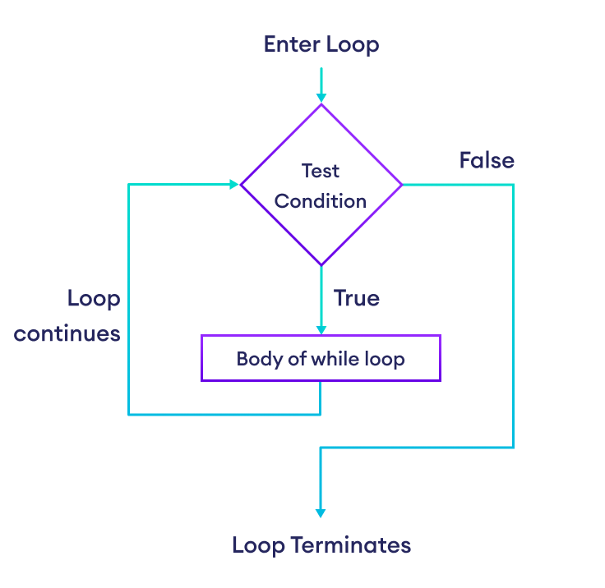
while loop
Syntax:
while condition:
<body>

Slide 65
while loop
Syntax:
while condition:
<body>
Example:
countdown = 5
while countdown > 0:
  print(countdown)
  countdown -= 1 # countdown = countdown - 1
print("Boom!")

Slide 66
while loop
Syntax:
while condition:
<body>
Example:
countdown = 5
while countdown > 0:
  print(countdown)
  countdown -= 1 # countdown = countdown - 1
print("Boom!")
Output:
    5
    4
    3
    2
    1
    Boom!

Slide 67
while loop
Syntax:
while condition:
<body>
Example:
countdown = 5
while countdown > 0:
  print(countdown)
  countdown -= 1 # countdown = countdown - 1
print("Boom!")

Slide 68
while loop
Syntax:
while condition:
<body>
Example:
Output:
    5
    Boom!
    4
    Boom!
    3
    Boom!
    2
    Boom!
    1
    Boom!
countdown = 5
while countdown > 0:
  print(countdown)
  countdown -= 1 # countdown = countdown - 1
print("Boom!")

Slide 69
while loop
Syntax:
while condition:
<body>
Example:
Output:
    5
    Boom!
    4
    Boom!
    3
    Boom!
    2
    Boom!
    1
    Boom!
countdown = 5
while countdown > 0:
  print(countdown)
  countdown -= 1 # countdown = countdown - 1
print("Boom!")
while loop scope

Slide 70
while loop
Syntax:
while condition:
<body>
Example:
Output:
    5
    Boom!
    4
    Boom!
    3
    Boom!
    2
    Boom!
    1
    Boom!
countdown = 5
while countdown > 0:
  print(countdown)
  countdown -= 1 # countdown = countdown - 1
print("Boom!")
while loop scope
Same level indentation

Slide 71
Practice:
Task: Write a function take_user_input(). The function keeps asking the user for a positive number until they provide one. Returns the number.
def take_user_input() -> int:
  '''
  Prompts the user to enter a positive number and returns it.
  Args:
  None
  Returns:
  int: The positive number entered by the user.
  '''
Sample output:
  Enter a positive number: -1
  Invalid input. Please enter a positive number.
  Enter a positive number: -2
  Invalid input. Please enter a positive number.
  Enter a positive number: -100
  Invalid input. Please enter a positive number.
  Enter a positive number: 100
  You entered: 100
number = take_user_input()
print(f"You entered: {number}")

Slide 72
break
The break statement terminate a loop prematurely.

Slide 73
break
The break statement terminate a loop prematurely.
When break is encountered within a loop (for, while), the execution of that loop immediately stops

Slide 74
break
The break statement terminate a loop prematurely.
When break is encountered within a loop (for, while), the execution of that loop immediately stops
The program’s control flow moves to the statement immediately following the loop.

Slide 75
break
The break statement terminate a loop prematurely.
When break is encountered within a loop (for, while), the execution of that loop immediately stops
The program’s control flow moves to the statement immediately following the loop.
Example:
for i in range(10):
  if i == 5:
  break
  print(i)
print ("Loop ended.")

Slide 76
break
The break statement terminate a loop prematurely.
When break is encountered within a loop (for, while), the execution of that loop immediately stops
The program’s control flow moves to the statement immediately following the loop.
Example:
for i in range(10):
  if i == 5:
  break
  print(i)
print ("Loop ended.")
Output:
0
1
2
3
4
Loop ended.

Slide 77
break
The break statement terminate a loop prematurely.
When break is encountered within a loop (for, while), the execution of that loop immediately stops
The program’s control flow moves to the statement immediately following the loop.
Example:
for i in range(10):
  if i == 5:
  break
  print(i)
print ("Loop ended.")
Output:
0
1
2
3
4
Loop ended.

Slide 78
break
The break statement terminate a loop prematurely.
When break is encountered within a loop (for, while), the execution of that loop immediately stops
The program’s control flow moves to the statement immediately following the loop.
Example:
for i in range(10):
  if i == 5:
  break
  print(i)
print ("Loop ended.")
Output:
0
1
2
3
4
Loop ended

Slide 79
break
The break statement terminate a loop prematurely.
When break is encountered within a loop (for, while), the execution of that loop immediately stops
The program’s control flow moves to the statement immediately following the loop.
Example:
num = 1
while True:
square = num * num
if square > 50:
print(f"{num} squared is {square} > 50.")
print ("stopping")
break
num += 1

Slide 80
break
The break statement terminate a loop prematurely.
When break is encountered within a loop (for, while), the execution of that loop immediately stops
The program’s control flow moves to the statement immediately following the loop.
Example:
num = 1
while True:
square = num * num
if square > 50:
print(f"{num} squared is {square} > 50.")
print ("stopping")
break
num += 1
Output: 8 squared is 64 > 50.
stopping

Slide 81
break
The break statement terminate a loop prematurely.
When break is encountered within a loop (for, while), the execution of that loop immediately stops
The program’s control flow moves to the statement immediately following the loop.
Example:
Infinite loop
num = 1
while True:
square = num * num
if square > 50:
print(f"{num} squared is {square} > 50.")
print ("stopping")
break
num += 1
Output: 8 squared is 64 > 50.
stopping

Slide 82
break
The break statement terminate a loop prematurely.
When break is encountered within a loop (for, while), the execution of that loop immediately stops
The program’s control flow moves to the statement immediately following the loop.
Example:
num = 1
while True:
square = num * num
if square > 50:
print(f"{num} squared is {square} > 50.")
print ("stopping")
break
num += 1
Exit with satisfied condition
Output: 8 squared is 64 > 50.
stopping

Slide 83
continue
The continue statement skips the rest of the code in the current iteration.

Slide 84
continue
The continue statement skips the rest of the code in the current iteration.
The program jumps to the top for the next iteration.

Slide 85
continue
The continue statement skips the rest of the code in the current iteration.
The program jumps to the top for the next iteration.
Example:
for i in range(10):
  if i % 2 == 0:
  continue
  print(i)

Slide 86
continue
The continue statement skips the rest of the code in the current iteration.
The program jumps to the top for the next iteration.
Example:
for i in range(10):
  if i % 2 == 0:
  continue
  print(i)
Output:
1
3
5
7
9

Slide 87
continue
The continue statement skips the rest of the code in the current iteration.
The program jumps to the top for the next iteration.
Example:
for i in range(10):
  if i % 2 == 0:
  continue
  print(i)
For all the numbers in [0,10)
Output:
1
3
5
7
9

Slide 88
continue
The continue statement skips the rest of the code in the current iteration.
The program jumps to the top for the next iteration.
Example:
for i in range(10):
  if i % 2 == 0:
  continue
  print(i)
If i is even…
Output:
1
3
5
7
9

Slide 89
continue
The continue statement skips the rest of the code in the current iteration.
The program jumps to the top for the next iteration.
Example:
for i in range(10):
  if i % 2 == 0:
  continue
  print(i)
…skip the rest of the statements in the for loop , which is the print statement.
Output:
1
3
5
7
9

Slide 90
continue
The continue statement skips the rest of the code in the current iteration.
The program jumps to the top for the next iteration.
Example:
for i in range(10):
  if i % 2 == 0:
  continue
  print(i)
Only runs for odd numbers
Output:
1
3
5
7
9

Slide 91
continue
The continue statement skips the rest of the code in the current iteration.
The program jumps to the top for the next iteration.
Example:
for i in range(10):
  if i % 2 == 0:
  continue
  print(i)
Output:
1
3
5
7
9

Slide 92
def take_user_input() -> int:
"""
Prompts the user to enter a positive number and returns it.
Args:
None
Returns:
int: The positive number entered by the user.
"""
while True:
user_input = input("Enter a positive number: ")
number = int(user_input)
if number > 0:
return number
else:
print("Invalid input. Please enter a positive number.")
number = take_user_input()
print(f"You entered: {number}")

